Slide 1


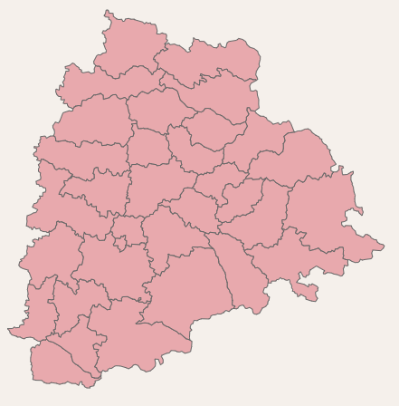



Telangana Growth Analysis
Registration & Stamps Department Transport Department TS - iPASS
CREATED BY VENKAT ROHITH KANDULA

Slide 2
Objectives
In a partnership with Code Basics, the Telangana government has made their data available as open-source material, which can be utilized by students for educational purposes and draw insights from the data.
The objective is to conduct a quantitative analysis of Telangana's progress across various sectors and provide meaningful insights to the government to make data-driven decisions that support the growth of the state.

Slide 3
About The State
Telangana, the most recently formed Indian state, comprises 33 districts.
With a population of approximately 3.8 crores, it ranks as the 12th most populous state in India.
Telangana has a notable urban population of 39% and a substantial rural population of 61%.
The state's literacy rate stands at approximately 67%.
Agriculture and allied activities, industries and service sectors are the major contributors to the Telangana state Economy.

Slide 4
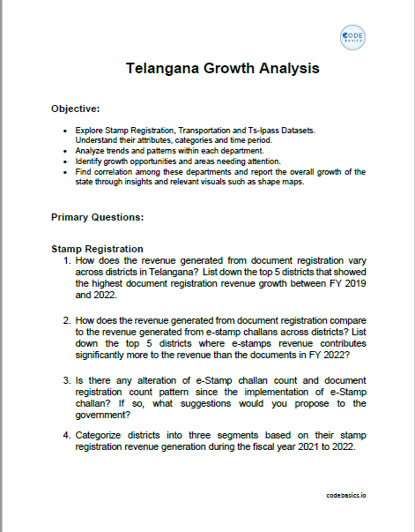
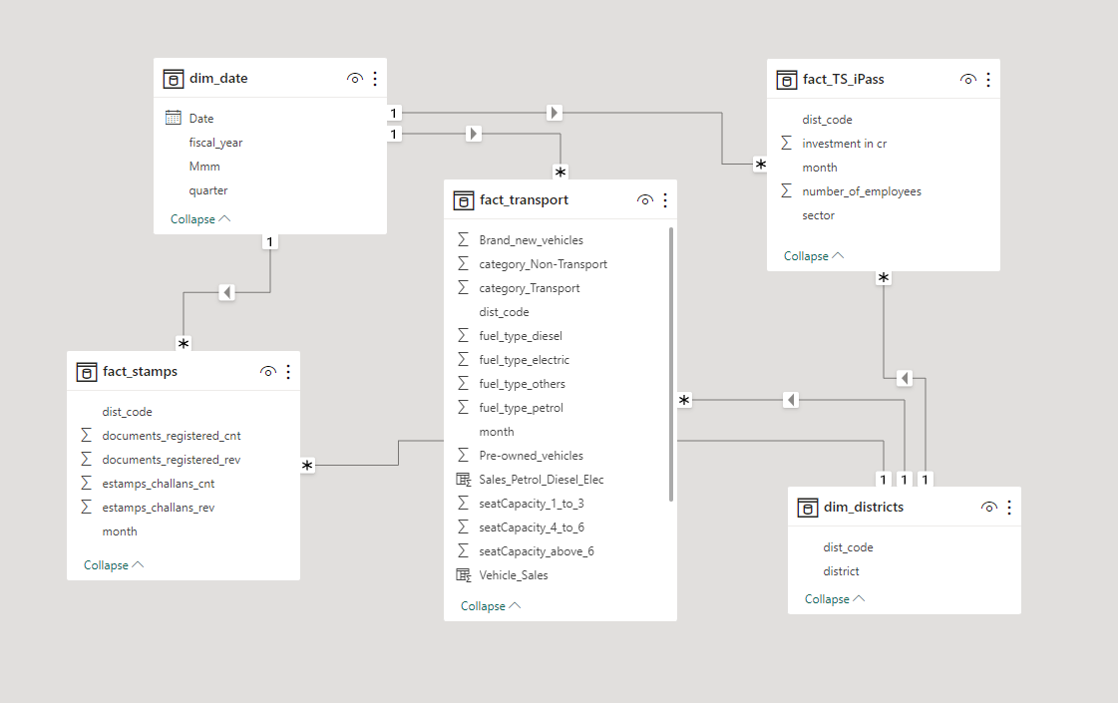
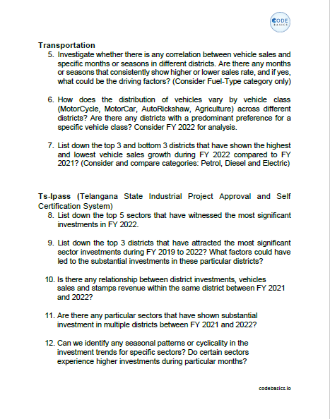
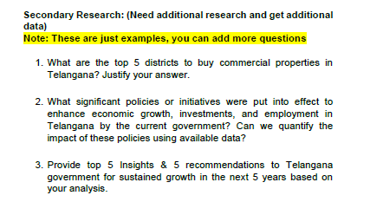


DATA and Tools
Excel
For Analysis and Visualization
Power BI

Slide 5
E Stamps and Document Registration
E-stamps, available through the Registration and Stamps Department of Telangana's website, are digital substitutes for traditional paper stamps.
. E-stamps are essential for paying stamp duty, a government tax applicable to various transactions involving property .
Document registration, a process carried out through the Registration and Stamps Department, involves recording information in official records to establish the legal validity and authenticity of a document while preventing fraud and forgery.
Different types of documents, including sale deeds, gift deeds, mortgage deeds, lease deeds, and release deeds, require registration to ensure their legal recognition.

Slide 6
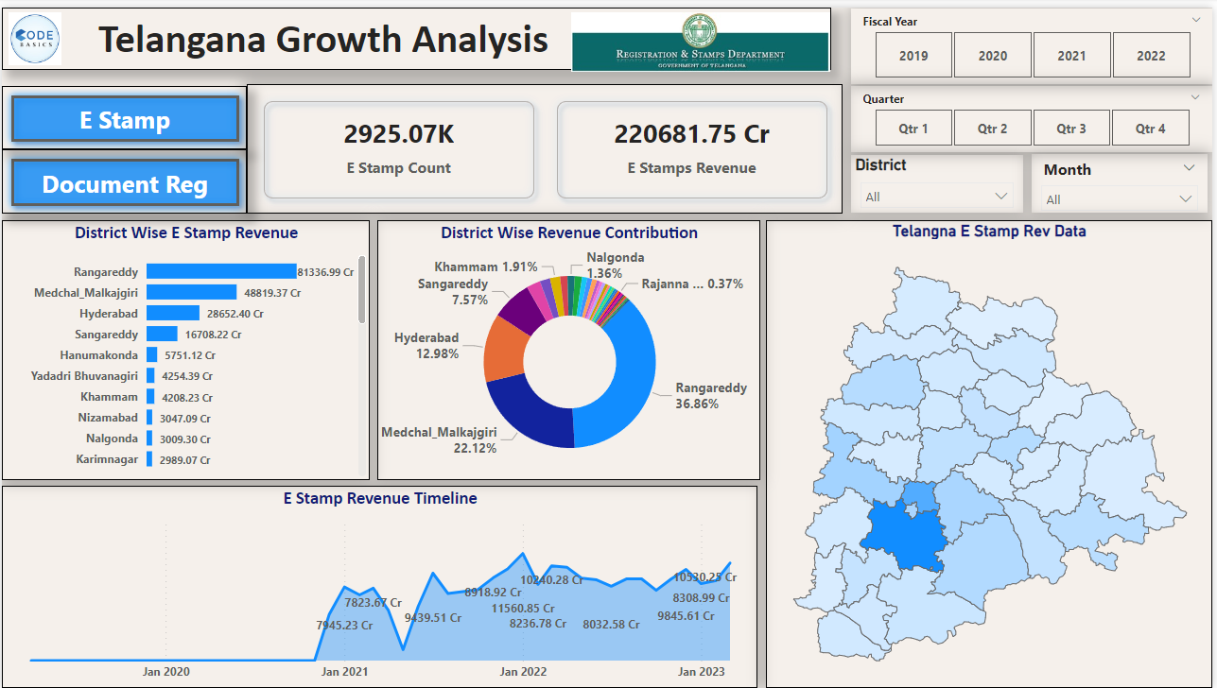
E Stamp Dashboard

Slide 7
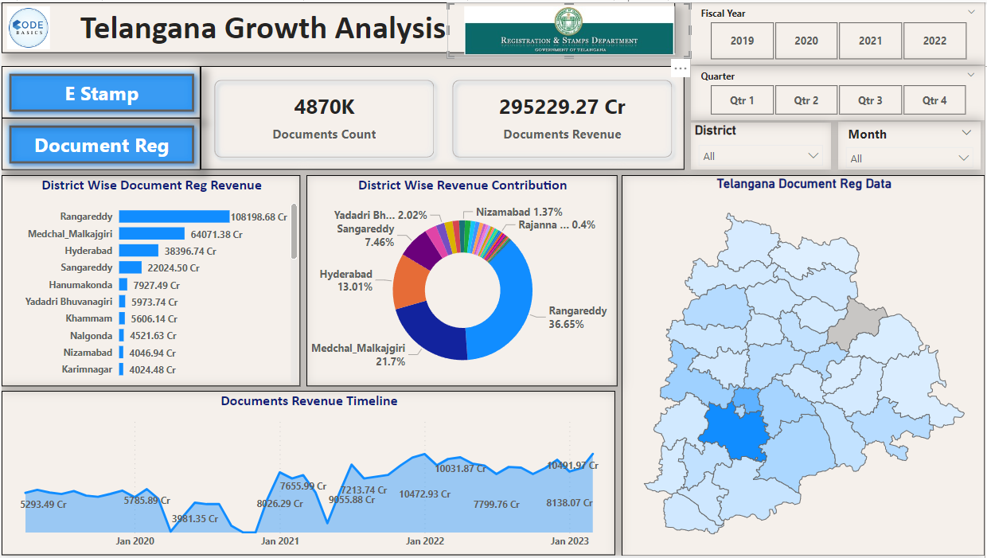
Document Registration Dashboard

Slide 8
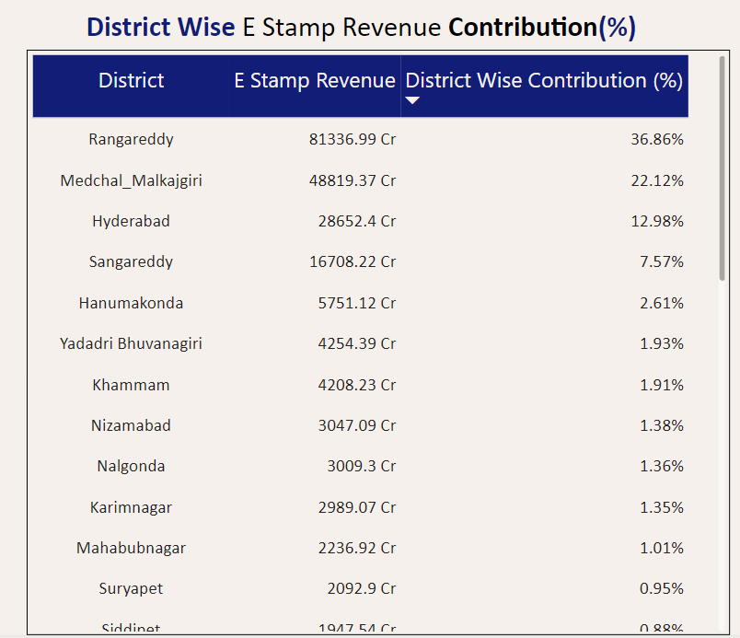
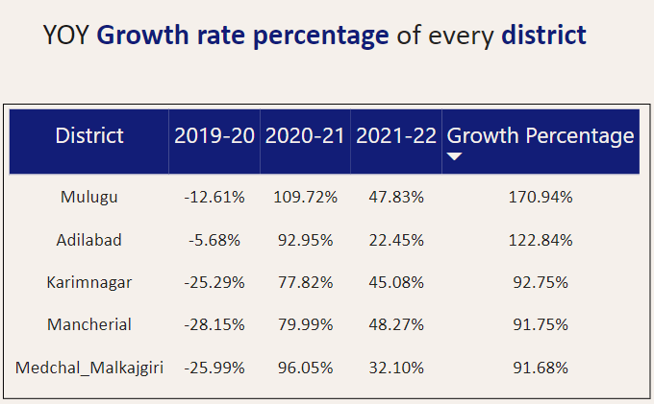
1.How does the revenue generated from document registration vary across districts in Telangana?
List down the top 5 districts that showed the highest document registration revenue growth between FY 2019 and 2022.
Insight:
Three districts - Rangareddy, Medchal-Malkajgiri, and Hyderabad - make up 71% of E Stamp revenue in the Hyderabad metropolitan region.
From 2019 to 2022, five districts, including Medchal-Malkajgiri, Karimnagar, Mancherial, Mulugu, and Adilabad, have seen substantial revenue growth. Urban districts show more city-centre property transactions, while rural areas benefit from increased agricultural and rural property transactions.

Slide 9
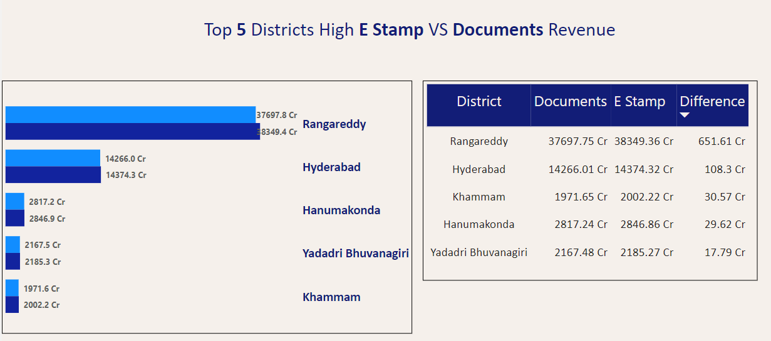
2.How does the revenue generated from document registration compare to the revenue generated from e-stamp challans across districts?
List down the top 5 districts where e-stamps revenue contributes significantly more to the revenue than the documents in FY 2022?
Insights:
Several districts in Telangana, including Rangareddy, Hyderabad, Khammam, Hanumakonda, and Yadadri Bhuvanagiri, now generate more revenue from E Stamps than traditional document registration, indicating a shift towards digital transactions.
The growing popularity of E-stamps in these districts can be attributed to their convenience, transparency, and alignment with digitalization trends, driven by urbanization and increased property transactions in both urban and rural areas.

Slide 10
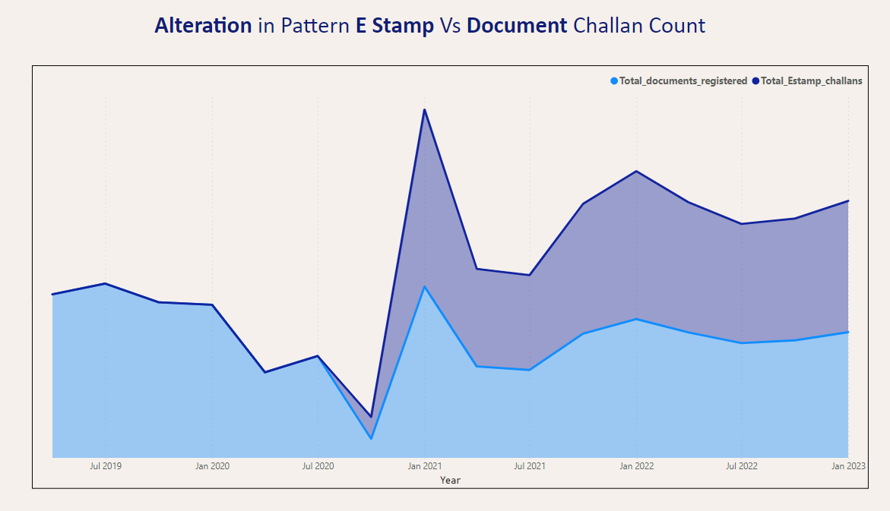
3. Is there any alteration of the e-Stamp challan count and document registration count pattern since the implementation of
The e-Stamp challan? If so, what suggestions would you propose to the government?
Insights:
Since the introduction of E-stamps, we've seen a higher usage of E-stamps compared to traditional document registrations.
This is because the number of E-stamp challans needed per document varies based on the property's value.

Slide 11
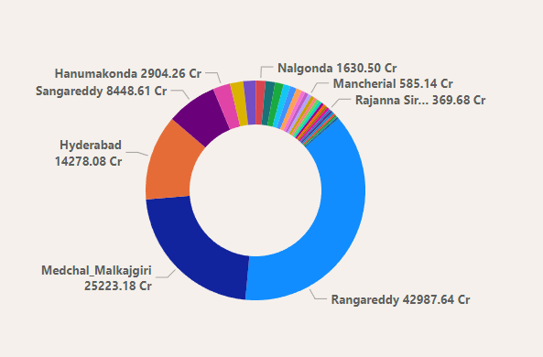
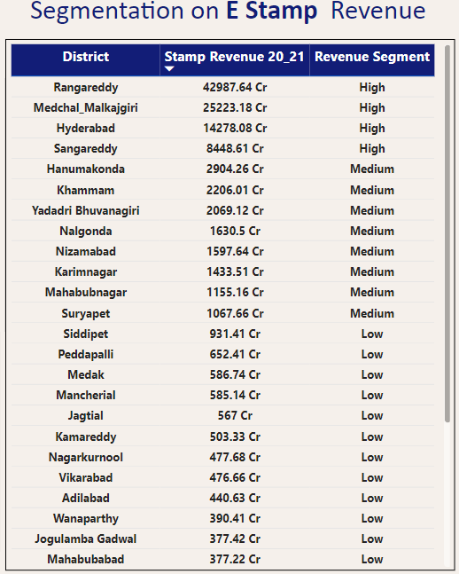
4. Categorize districts into three segments based on their stamp registration revenue generation during the fiscal year 2021 to 2022.
Insights:
High revenue: Districts in Hyderabad Metropolitan Region with over 8,000 crores.
Medium revenue: Districts with revenue between 1,000 and 8,000 crores.
Low revenue: Districts below 1,000 crores.

Slide 12
Transport Department
It is a government agency that regulates and facilitates road transportation and road safety in Telangana, India.
It enforces the Motor Vehicles Act and Rules, collects taxes and fees, issues driving licenses and certificates of fitness, and registers and permits vehicles.
It promotes road safety and awareness among the public through various campaigns, programs, and initiatives.
It provides various online services to citizens through its website and portal.

Slide 13
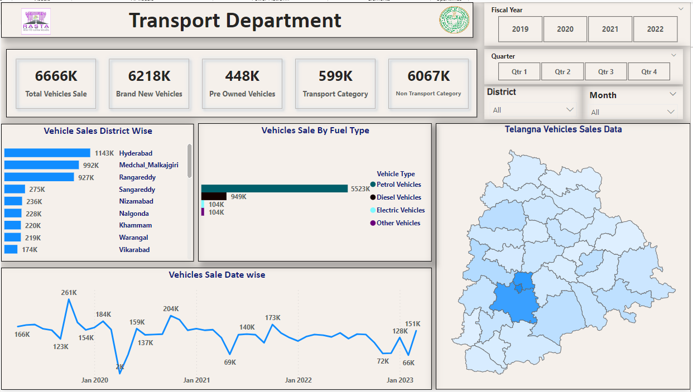
Transport Dashboard

Slide 14
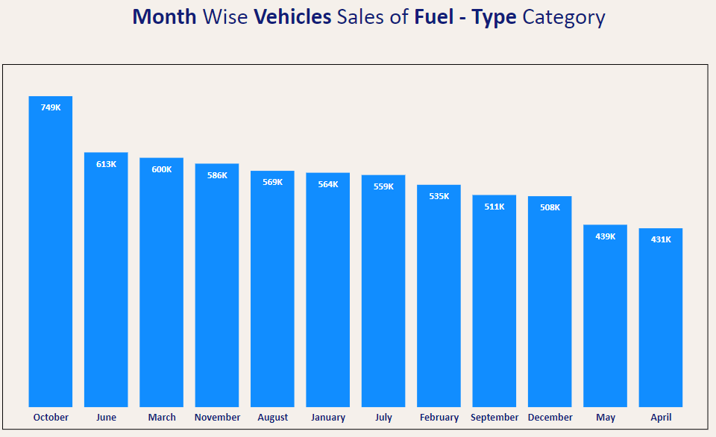
5. Investigate whether there is any correlation between vehicle sales and specific months or seasons in different districts. Are there any months or seasons that consistently show higher or lower sales rate, and if yes, what could be the driving factors? (Consider Fuel-Type category only)
Insights:
October witnesses a spike in vehicle sales, driven by the popular Batakamma and Dasara festivals celebrated during this month, making it a preferred time for purchases.
In contrast, April and May experience reduced vehicle sales due to the summer weather and high temperatures.

Slide 15
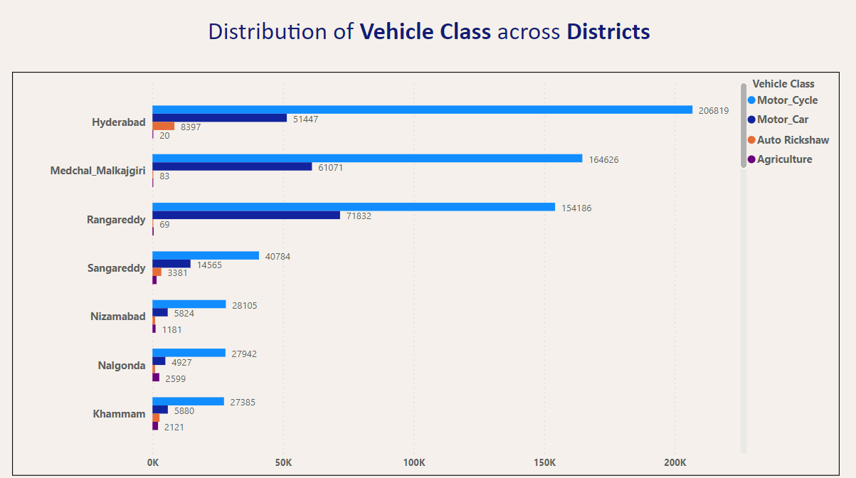

6. How does the distribution of vehicles vary by vehicle class (MotorCycle, MotorCar, AutoRickshaw, Agriculture) across different districts? Are there any districts with a predominant preference for a specific vehicle class? Consider FY 2022 for analysis.

Slide 16
Insights:
Hyderabad, being the capital, leads in vehicle sales across all types, driven by its urban population rather than agricultural vehicles.
High sales of motorcycles and motor cars are observed in Hyderabad, Rangareddy, and Medchal Malkajgiri districts, primarily due to the significant urban population within the Hyderabad Metropolitan region.
Motorcycles are a popular choice for transportation in most districts.
The number of auto-rickshaws varies among districts, with Sangareddy having the highest count.
Rural areas experience higher sales of agricultural vehicles, with Nalgonda, Siddipet, and Suryapet recording the highest numbers due to increased agricultural activity resulting from irrigation projects like the Kaleshwaram lift irrigation. Urban areas have fewer sales in this category.

Slide 17
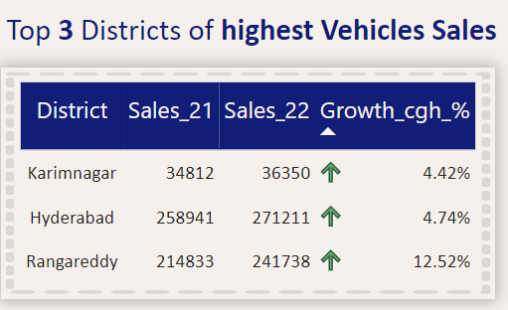
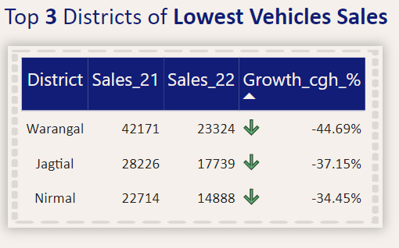
7. List down the top 3 and bottom 3 districts that have shown the highest and lowest vehicle sales growth during FY 2022 compared to FY 2021? (Consider and compare categories: Petrol, Diesel and Electric)
Insights:
Ranga Reddy, Hyderabad, and Karimnagar districts witnessed significant sales growth, while Warangal, Jagityal, and Nirmal districts experienced comparatively lower growth compared to the previous fiscal year.

Slide 18
TS – iPASS
TS-iPASS is a certification service designed to facilitate the establishment of industries, manufacturing, and services within the state of Telangana, India. This single-window system streamlines the process for entrepreneurs to apply for the necessary clearances and permissions needed to initiate and operate their businesses in the state.
1. Self-Certification: Entrepreneurs can apply without the need to submit supporting documents or proofs, relying on their self-certification.
2. Time-Bound Approvals: The system commits to providing approvals within 15 days for mega projects and 30 days for other projects. Failure to meet these timelines results in automatic approval.
3. Unified Online Portal: TS-iPASS offers a single online platform for submitting clearance and permission applications, as well as tracking their status.
4.Escalation and Penalties: It incorporates mechanisms for escalating pending applications to higher authorities and imposing penalties on officials responsible for delays.
5. Incentives and Subsidies: Eligible industries and sectors can benefit from incentives such as investment subsidies, stamp duty reimbursement, power tariff subsidies, interest subsidies, and more.
TS-iPASS aims to foster an investor-friendly environment in Telangana, attracting increased investments and employment opportunities while promoting business ease and transparency within the industrial sector.

Slide 19
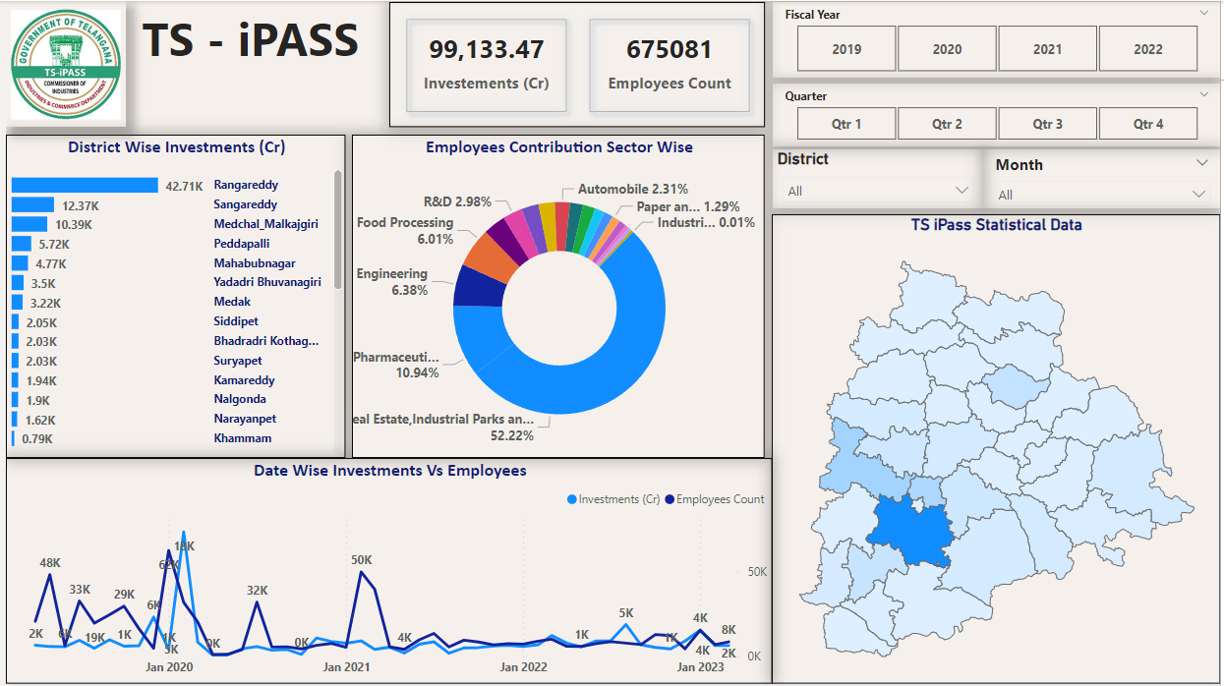
TS - iPASS Dashboard

Slide 20
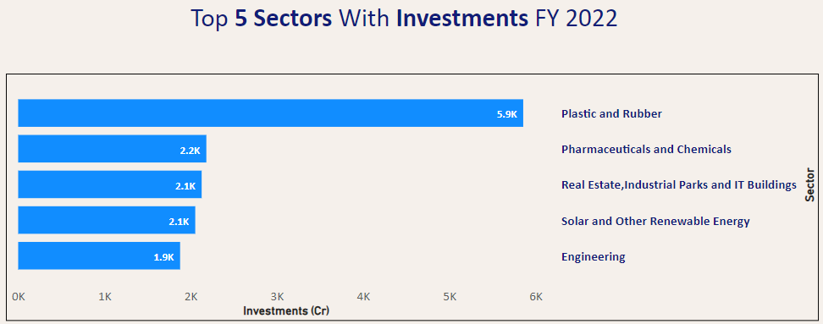
8.List down the top 5 sectors that have witnessed the most significant investments in FY 2022.
Insights:
These 5 sectors have witnessed High investments in the FY 2022

Slide 21
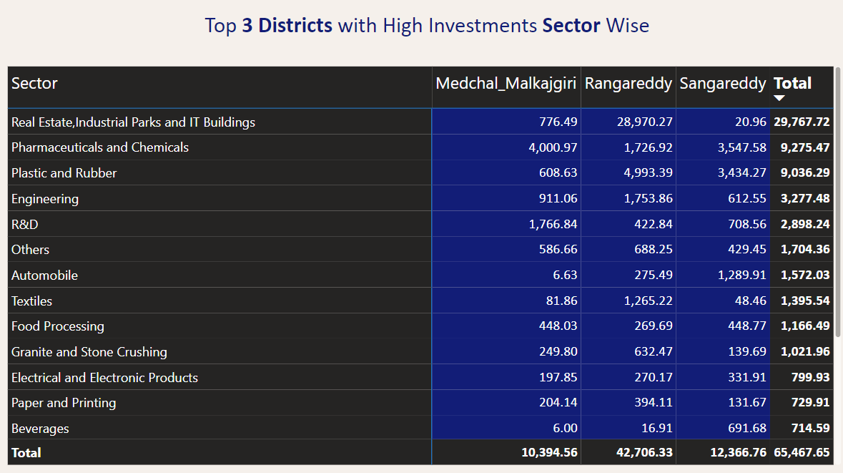
9. List down the top 3 districts that have attracted the most significant sector investments during FY 2019 to 2022?
What factors could have led to the substantial investments in these particular districts?

Slide 22
Insights:
1. Rangareddy, Sangareddy, and Medchal Malkajgiri, located in the capital area, have emerged as significant magnets for sector-specific investments, contributing to Hyderabad's allure.
2. Hyderabad is a premier investment hub, spanning various sectors like pharma, life sciences, chemicals, plastics, real estate, IT, and industrial parks. This is due to its favorable factors such as government backing, robust infrastructure, a skilled workforce, and proximity to ports.
3. The Hyderabad Metropolitan Region, notably Rangareddy, Sangareddy, and Medchal Malkajgiri, holds special appeal for investors, especially in industries like pharma, life sciences, and chemicals, further cementing Hyderabad's status as a top destination.
4. Hyderabad has cultivated a well-established ecosystem, fostering research, production, skill development, and infrastructure for the pharma, life sciences, and chemical sectors.
5. Beyond these sectors, the city continues to attract investments in real estate, IT, and industrial parks, continually strengthening its position as a preferred investment destination.

Slide 23
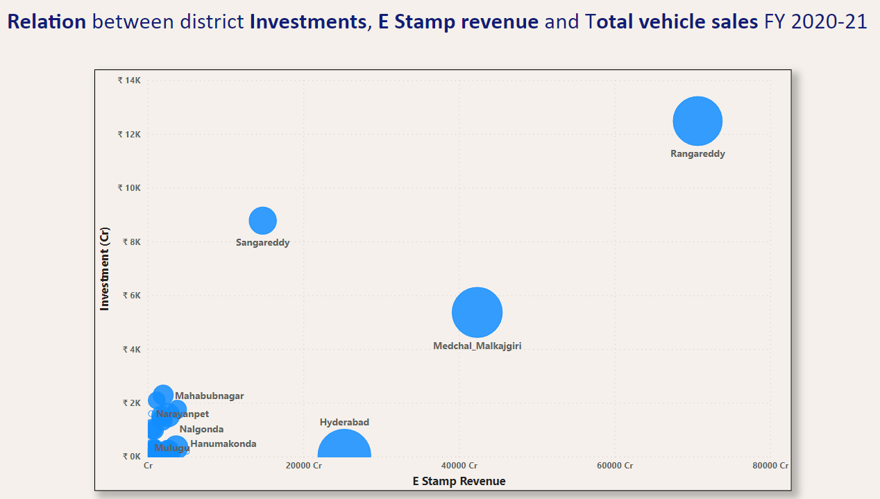
10. Is there any relationship between district investments, vehicles sales and stamps revenue within the same district between FY 2021 and 2022?
Insights:
1. There is a clear positive correlation observed between district investments, vehicle sales, and stamp revenue during the 2021-2022 financial year.
2. The visual data indicates a simultaneous rise in district investments, vehicle sales, and stamp revenue.
3. The upsurge in district investments leads to heightened real estate and property transactions, contributing significantly to the increased revenue from E Stamp.
4. This economic growth has a direct impact on the income levels of individuals, leading to more vehicle purchases.
5. In summary, increased district investments have a cascading effect on various sectors, boosting income sources and driving higher vehicle sales.

Slide 24
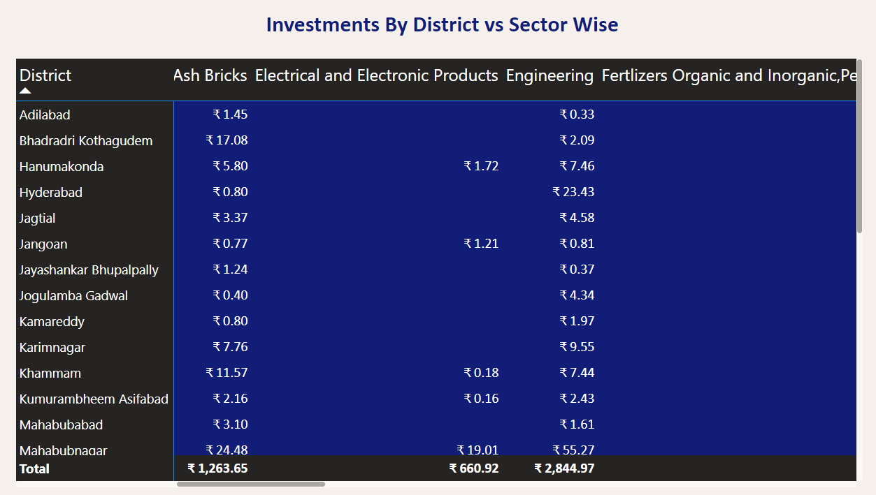
11. Are there any particular sectors that have shown substantial investment in multiple districts between FY 2021 and 2022?
Insights:
Sectors such as industrial parks and IT facilities, food processing, cement and concrete production, and agro-based cold storage facilities have witnessed significant investments across various districts during the fiscal year 2021-2022.

Slide 25
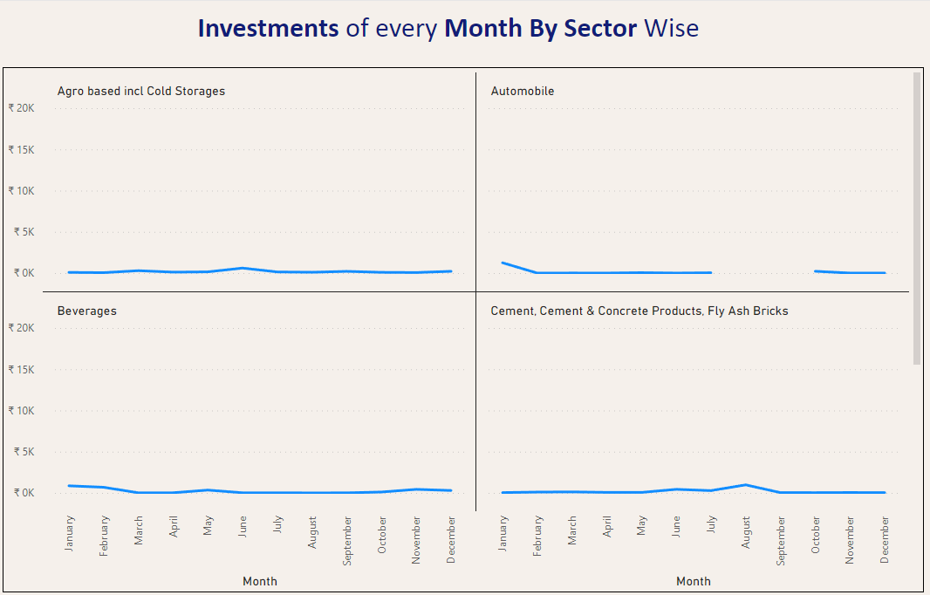
12. Can we identify any seasonal patterns or cyclicality in the investment trends for specific sectors? Do certain sectors experience higher investments during particular months?
Insights:
1. There are no clear indications of specific sectors displaying seasonal or cyclical investment patterns associated with particular seasons or months.
2. Nonetheless, certain sectors like Engineering in February, Fertilizers in December, Real Estate and Development in February, and Textiles in September have reported higher levels of investment during specific months.

Slide 26
Secondary Research…

Slide 27
1. What are the top 5 districts to buy commercial properties in Telangana? Justify your answer.
Medchal-Malkajgiri
Hyderabad
Rangareddy
Sangareddy
Hanumakonda
Yadadri Bhuvanagiri
Reasons:
Urban Centres
Robust Infrastructure facilities
Investements and economic growth
Employment Opportunities
Transportation Connectivity

Slide 28
2. What significant policies or initiatives were put into effect to enhance economic growth, investments, and employment in Telangana by the current government? Can we quantify the impact of these policies using available data?
Infrastructure Development:
TS – iPASS and T HUB, T - Works: Promoting investment and innovation hubs.
24/7 Availability of Quality Power: Ensuring uninterrupted power supply for all sectors.
Major Lift Irrigation Projects: Enhancing water resources management.
2. Infrastructure and Investment:
Global Investments: Attracting international investors by Creating Infrastructure Meeting International Standards.
Creating New Industrial Parks: Facilitating industrial growth in all Sectors.
3. Law and Order:
Effective Law and Order: Ensuring safety for citizens and investors.

Slide 29
4. Connectivity and Transport:
Connectivity and Public Transport: Enhancing transportation networks for better mobility.
5. Rural and Urban Development:
Pattana Pragathi – Palle Pragathi: Transforming rural and urban areas.
6. Farmer Support Schemes:
Rythu Bandhu: Providing support to farmers through direct income assistance.
Subsidies and Encouragement for Agriculture: Boosting agriculture and allied sectors.
24/7 Availability of Quality Power: Ensuring uninterrupted power supply for Agriculture.
Major Lift Irrigation Projects: Enhancing water resources management.

Slide 30
Impact of these Polices from Available Data:
Policies like TS - iPASS, infrastructure development, and the creation of industrial parks for all sectors have resulted in substantial investments in the state.
Due to these increased investments, there has been significant growth in real estate and property transactions, leading to a substantial increase in E-Stamp Revenue.
The government's proactive initiatives and newly implemented policies have led to a boost in both rural and urban economies.
As a result, people's incomes and purchasing power have risen noticeably, reflecting this economic growth through increased vehicle sales in the transportation sector.

Slide 31
Insights
Urban Economy:
1. Creating new industrial parks and providing high-standard infrastructure.
2. By ensuring access to a drinking water supply to all and 24-hour power, maintaining law and order, improving road facilities, and offering affordable public transport
3. Policies like TS-iPASS and TS-B Pass have attracted local and international investors to invest in the state.
4. Expanding sectors such as Pharma and IT has created more job opportunities and income sources for both the people and the government.
5. Diversifying major sectors beyond the capital region into district headquarters and other areas.

Slide 32
Rural Economy:
1. The construction of major lift irrigation projects like Kaleshwaram and Palamuru-Rangareddy has significantly increased agricultural production, elevating the state to the top rank in the country.
2. Providing investment support schemes like Raithu - bandhu, ensuring 24-hour quality power, and offering agricultural loan repayment assistance by the government benefit farmers.
3. Giving subsidies and promoting allied sectors of agriculture, such as fishing and livestock, has contributed to the rise in the rural economy, increasing the income sources of people in rural areas.
4. Programs like Palle Pragathi and Patana Pragathi, focused on rural and urban development, aim to enhance the quality of life by creating more livable spaces and improving cleanliness.
These initiatives, policies, and schemes by the government have shown tremendous growth in the state's economy over the past 5 years.

Slide 33
Recommendations
Detailed Report :
Continuous improvement in infrastructure facilities, such as enhancing transportation networks for better mobility and ensuring that the city is more liveable.
The length of the national highways in the state is approximately 4.6%. An increase in the length of the highways contributes to improved transportation connectivity and state logistics, enhancing transportation networks.
Developing the existing industrial parks and creating new special economic zones around the capital region, Hyderabad.
Creating relevant industrial parks In specific areas depending upon the availability of the workforce and the infrastructure in the urban and rural districts.
There is significant potential for growth in manufacturing and related sectors. It's better to focus more on attracting investments related to the manufacturing industry.

Slide 34
Creating relevant industrial parks for sectors like food processing and other manufacturing units in rural districts, which helps create more job opportunities and enables farmers to sell their agricultural products.
Helping farmers acquire knowledge about diversified and commercial crops to increase their sources of income, providing regular information related to weather and crop demand for the farmers to deal with uncertainties in farming
Providing more subsidies to allied sectors of agriculture and creating relevant sectors like meat processing and food processing in rural districts can contribute to the growth of the rural economy.
Properly maintaining existing lift irrigation projects and managing water storage dams and canals provide more facilities for the agriculture sector.

Slide 35

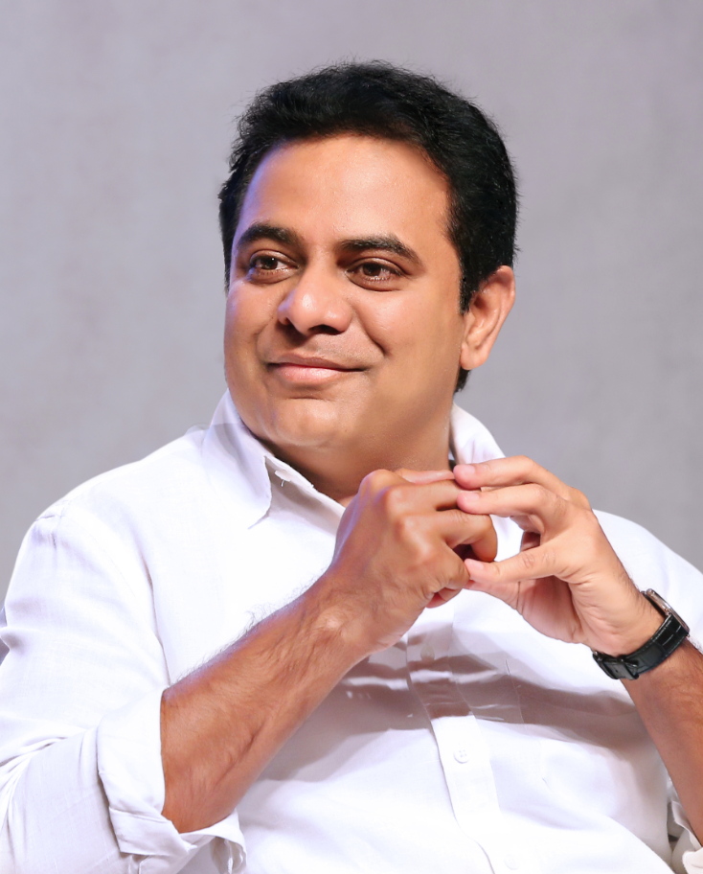


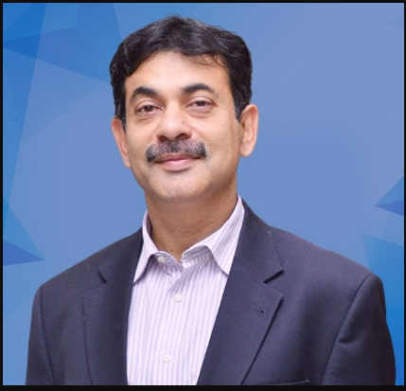
Thank You……

